Slide 1
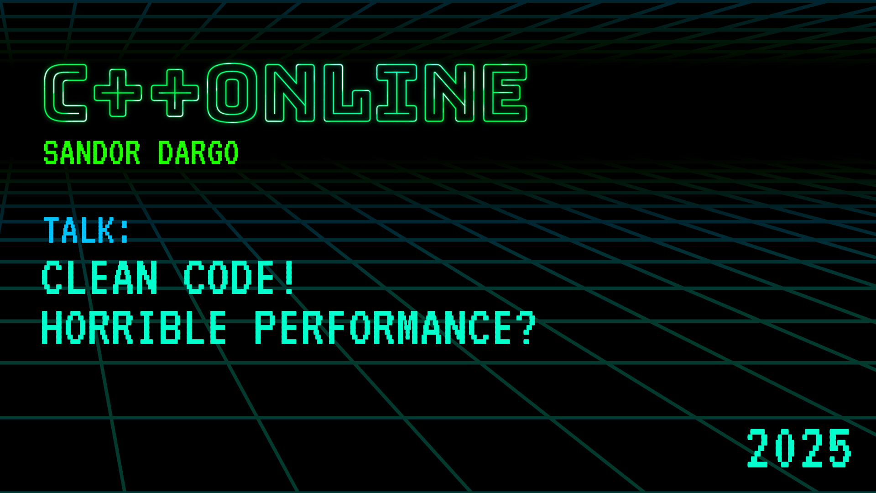


Clean code! Horrible performance?
Sandor Dargo
Meeting C++ 16th November 2024, Berlin
T W I T T E R @SandorDargo W E B sandordargo.com
Notes:
Main points are:
What is software quality & clean code
Their relationship
What can we do about them

Slide 2

Who Am I?
Sándor DARGÓ
Senior Engineer at Spotify
Enthusiastic blogger: sandordargo.com
Curious oenophile
Fortunate father of two
Notes:
‹#›

Slide 3
Why this talk?
Why clean code is not the norm (C++OnSea2023) lead to some discussions
I don’t like absolutes but too many people talk in absolutes
I think engineering is more nuanced

Slide 4
Agenda
What is clean code?
What is software quality?
Where and why do we use C++?
What is software performance?
Is clean code actually slower?
Should we drop clean code for faster code?
Does clean code imply horrible performance?

Slide 5
What is clean code?
What is clean code?
What is software quality?
Where and why do we use C++?
What is software performance?
Is clean code actually slower?
Should we drop clean code for faster code?
Does clean code imply horrible performance?

Slide 6
Clean code is NOT a closed set of rules
The book Clean Code != The concept of clean code
Depends on the language
Depends on the context
Changes over time
Not a silver bullet
Notes:
https://garywoodfine.com/what-is-clean-code/

Slide 7
Then what is clean code?
Notes:
We can share different attributes
A car is HQ because it never breaks down. But isn’t it just reliable?
A car is HQ because it’s fast. But isn’t it just fast?
A car is HQ because it uses expensive materials? But isn’t it just luxurious?
What is a fast car that uses expensive materials but that breaks down and catches on fire? Is it HQ?
These are still just characteristics.

Slide 8
Code that is easy to understand and easy to change
Notes:
We can share different attributes
A car is HQ because it never breaks down. But isn’t it just reliable?
A car is HQ because it’s fast. But isn’t it just fast?
A car is HQ because it uses expensive materials? But isn’t it just luxurious?
What is a fast car that uses expensive materials but that breaks down and catches on fire? Is it HQ?
These are still just characteristics.

Slide 9
Execution flow
Classes have concise public interfaces
Object relationships
Is easily testable and has unit tests
Easy to the understand the
Easy to change when
Roles and responsibilities
Entities are predictable and work as expected
Purpose of each expression
Entities are small and with one single responsibility
Notes:
https://garywoodfine.com/what-is-clean-code/

Slide 10
Clean code is part of software quality!
Notes:
We can share different attributes
A car is HQ because it never breaks down. But isn’t it just reliable?
A car is HQ because it’s fast. But isn’t it just fast?
A car is HQ because it uses expensive materials? But isn’t it just luxurious?
What is a fast car that uses expensive materials but that breaks down and catches on fire? Is it HQ?
These are still just characteristics.

Slide 11
Is high quality software important?
Notes:
Maybe we can move this to a later section, when we discuss the timeline of software development.

Slide 12
Quality isn’t so important when you
Build a proof of concept
Search a product market fit
Must deliver to survive
But what if you plan for a longer term?
Notes:
When or in which circumstances?

Slide 13
What is software quality?
What is clean code?
What is software quality?
Where and why do we use C++?
What is software performance?
Is clean code actually slower?
Should we drop clean code for faster code?
Does clean code imply horrible performance?

Slide 14
What is quality?
Notes:
We can share different attributes
A car is HQ because it never breaks down. But isn’t it just reliable?
A car is HQ because it’s fast. But isn’t it just fast?
A car is HQ because it uses expensive materials? But isn’t it just luxurious?
What is a fast car that uses expensive materials but that breaks down and catches on fire? Is it HQ?
These are still just characteristics.

Slide 15
Quality is undefinable
You recognize it when you see it
Notes:
We can share different attributes
A car is HQ because it never breaks down. But isn’t it just reliable?
A car is HQ because it’s fast. But isn’t it just fast?
A car is HQ because it uses expensive materials? But isn’t it just luxurious?
What is a fast car that uses expensive materials but that breaks down and catches on fire? Is it HQ?
These are still just characteristics.

Slide 16
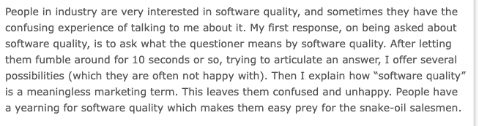
Software quality has several definitions
It might even be a meaningless term
According to Derek Jones (The aura of software quality)
Notes:
"Evidence-based Software Engineering: based on the publicly available data",
Talk about Phil Nash’s presentation CISQ
How his definition …
People in industry are very interested in software quality, and sometimes they have the confusing experience of talking to me about it. My first response, on being asked about software quality, is to ask what the questioner means by software quality. After letting them fumble around for 10 seconds or so, trying to articulate an answer, I offer several possibilities (which they are often not happy with). Then I explain how “software quality” is a meaningless marketing term. This leaves them confused and unhappy. People have a yearning for software quality which makes them easy prey for the snake-oil salesmen.

Slide 17

defines the 4 pillars of structural quality
Security
Reliability
Maintainability
Performance efficiency
Notes:
Romantic or classic?
quality a meaningless marketing term
Quality is undefinable - you recognize it when you see it

Slide 18
Clean code is part of software quality!
Helps reducing the number of bugs (Security, Reliability, Maintainability)
Helps reducing the time to fix bugs (Reliability, Maintainability)
Decreases maintenance costs (Maintainability)
Notes:
When or in which circumstances?

Slide 19
defines the 4 pillars of structural quality
Security
Reliability
Maintainability
Performance efficiency
What about performance?
Notes:
Romantic or classic?
quality a meaningless marketing term
Quality is undefinable - you recognize it when you see it

Slide 20
Where do we use C++?
What is clean code?
What is software quality?
Where and why do we use C++?
What is software performance?
Is clean code actually slower?
Should we drop clean code for faster code?
Does clean code imply horrible performance?

Slide 21
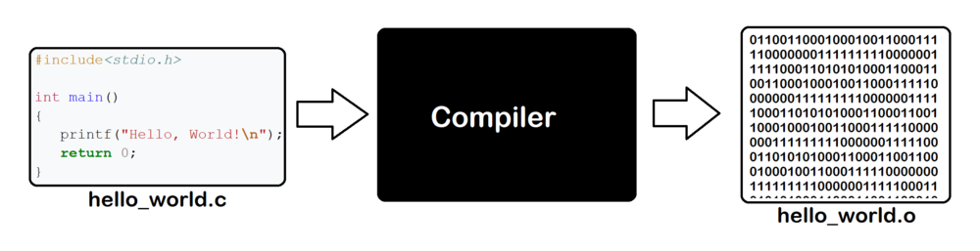



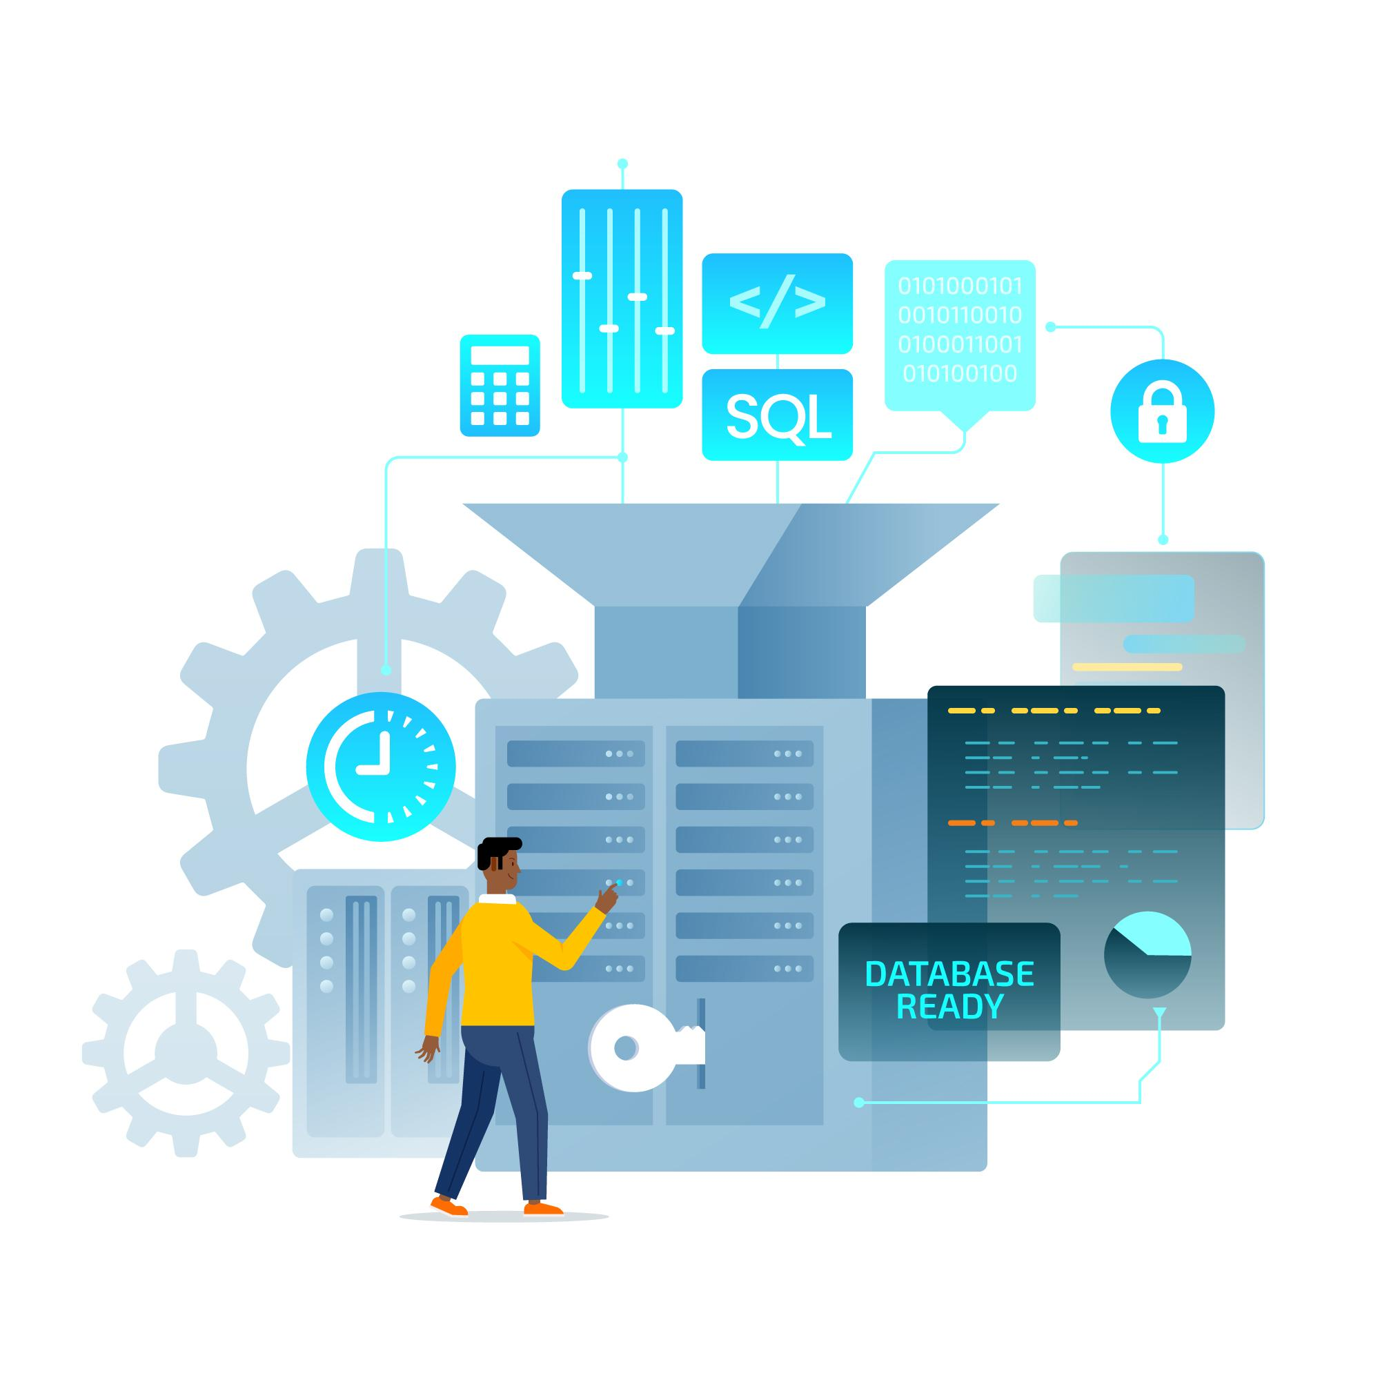


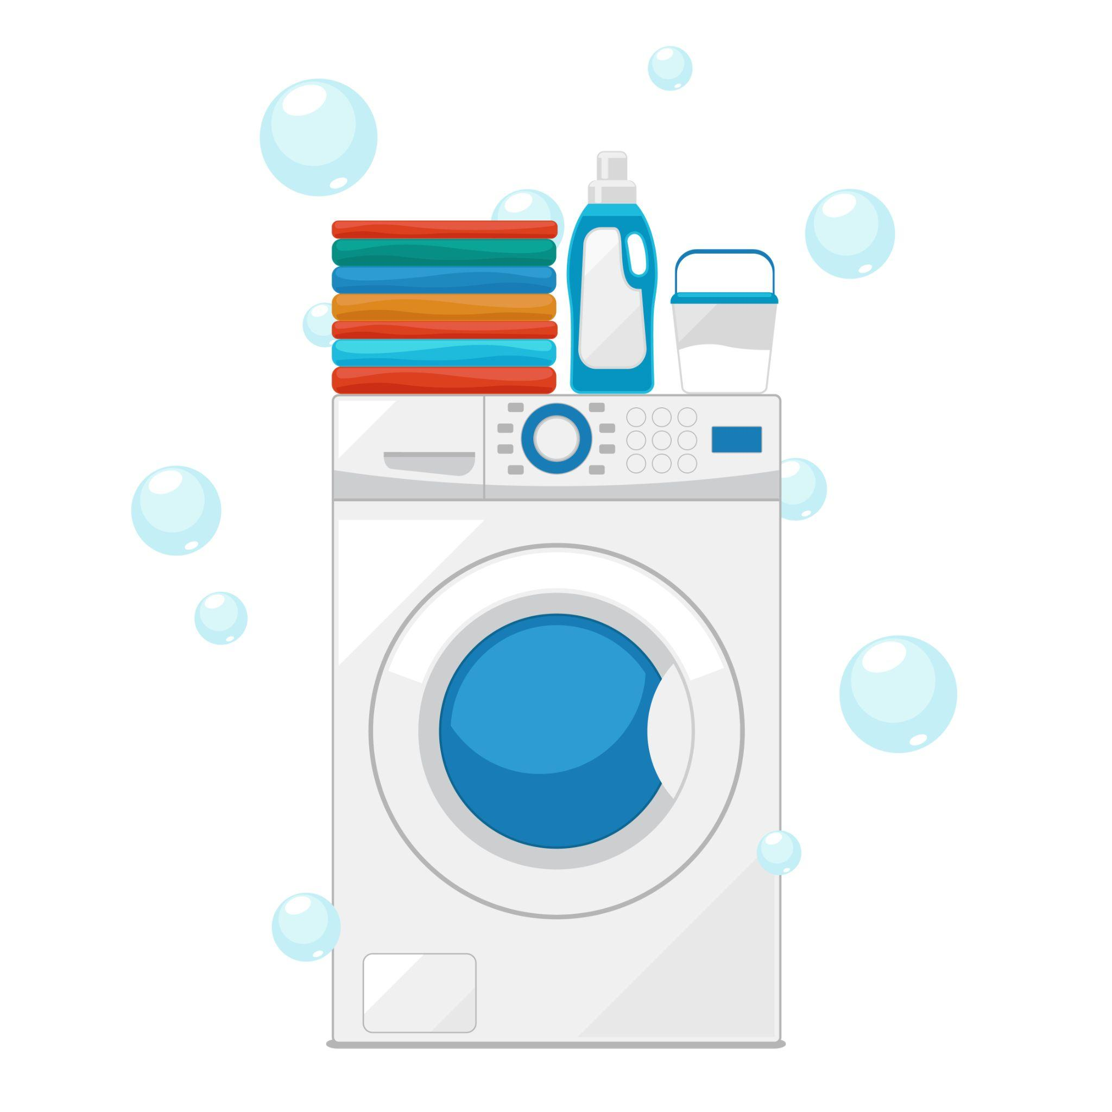

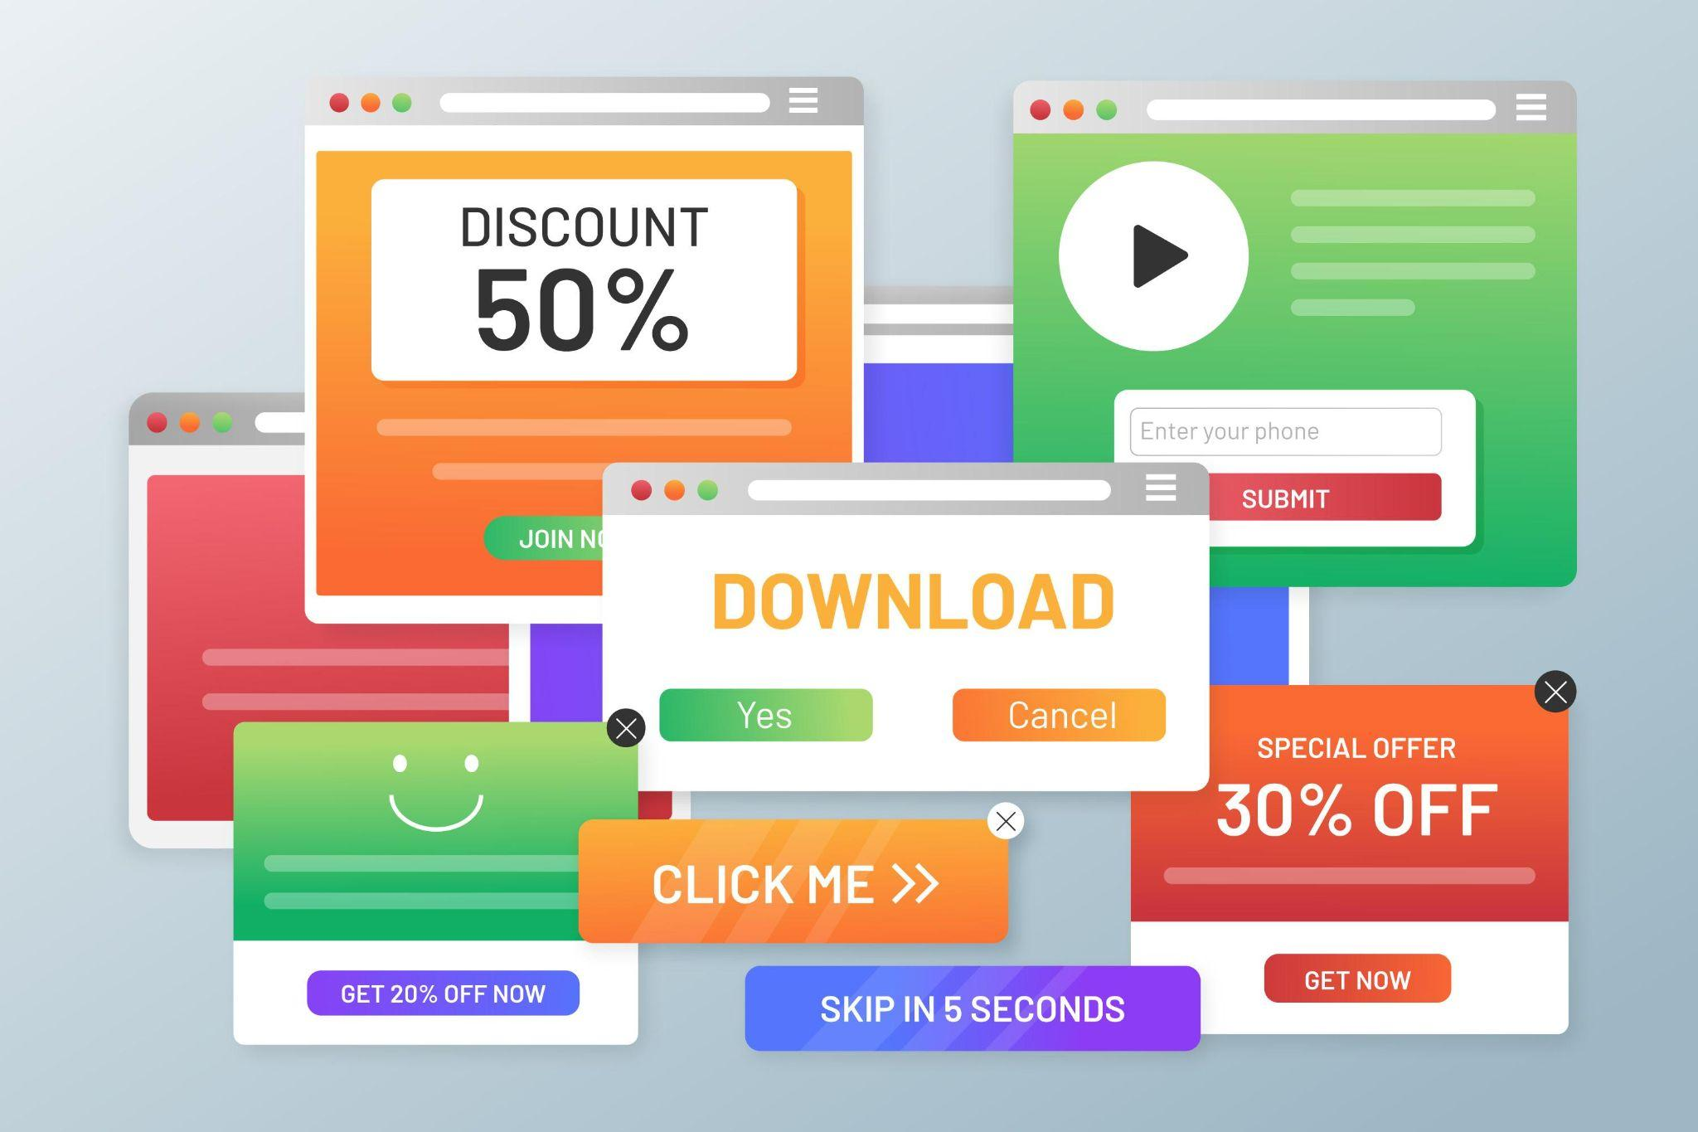

C++ is just everywhere
Notes:
<a href="https://www.freepik.com/free-vector/several-decorative-vehicles-cartoon-style_1080036.htm#query=car&position=9&from_view=keyword&track=ais_hybrid&uuid=e56241bb-3d62-4e21-abde-a6e8b1d84c00">Image by freepik</a>
In your phone Washing machine
Cars
Airplanes
Adobe Photoshop
3D Games
Browsers
Compilers
Operating systems
Enterprise software
Trading

Slide 22
Why do we use C++?
What is clean code?
What is software quality?
Where and why do we use C++?
What is software performance?
Is clean code actually slower?
Should we drop clean code for faster code?
Does clean code imply horrible performance?

Slide 23
Because it’s legacy!
It’s been with us since the 80s
Tons of (often complex and critical) existing code
Rewrites rarely make sense even if C++ is not needed
Loss of time
Problem of existing ecosystem
Problem of knowledge
Notes:
Maybe on two sides

Slide 24
C++ is also evolving!
Since C++11, stable and steady evolution
A new standard every 3 years
Safer and more expressive code
Not owned by a single corporation!

Slide 25
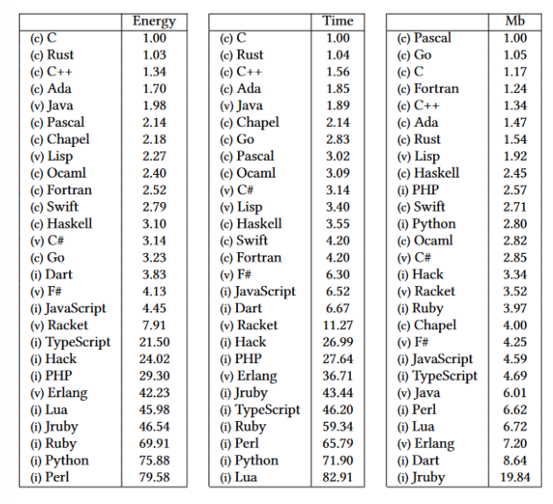
C++ has an economic advantage!
It’s fast!
Good for performance critical apps!
It uses little space!
Good for embedded
For anything that has to be distributed
Consumes less energy!
Good for everyone!
C++ is performant
Notes:
Find why

Slide 26
What is software performance?
What is clean code?
What is software quality?
Where and why do we use C++?
What is software performance?
Is clean code actually slower?
Should we drop clean code for faster code?
Does clean code imply horrible performance?

Slide 27
Performance is…
A non-functional characteristic
A non-functional requirement
A metric of efficiency
Like quality, nothing specific as a term
Notes:
Performance is a non-functional characteristic of a software. It's almost always a non-functional requirement as well. Even if it's not specifically mentioned, a software that is too slow - in a given context - is unusable and useless. In that sense, performance is a non-functional requirement that ensures that the software can achieve its functional requirements in a reasonable timespan.
We can think about software performance as how efficiently the software can accomplish its tasks. But it's still nothing specific. There are many several ways to describe and measure performance and efficiency.

Slide 28
Sufficient performance ensures that the software can achieve its functional requirements in a reasonable timespan
Notes:
We can share different attributes
A car is HQ because it never breaks down. But isn’t it just reliable?
A car is HQ because it’s fast. But isn’t it just fast?
A car is HQ because it uses expensive materials? But isn’t it just luxurious?
What is a fast car that uses expensive materials but that breaks down and catches on fire? Is it HQ?
These are still just characteristics.

Slide 29
Different aspects of software performance
Response time: how fast it responds
Throughput: how many requests it can handle
Resource utilization: how efficiently it uses system resources
Scalability: ability to maintain performance levels as the workload increases
Capacity: maximum load or number of users before severe performance degradation
Stability: ability to perform consistently over time without crashes, memory leaks, or other issues
Notes:
Put here definitions, and make the first word bolds

Slide 30
What is runtime performance?

Slide 31
Runtime performance == Execution speed?
It’s mostly about execution speed
It’s not only about algorithmic complexity
Language is important
Layers of abstractions can matter a lot
If neglected, other aspects will suffer
Notes:
Runtime performance is a crucial aspect of software performance, specifically focusing on how well the software operates while it is running or in execution. It directly influences the user experience and the overall efficiency of the system. Here's how runtime performance fits into the broader picture of software performance:
1. **Real-Time Response**: Runtime performance is primarily concerned with the immediate responsiveness of the software during execution. This includes how quickly the software can process inputs, execute tasks, and provide outputs or feedback to the user. It directly affects the **response time** component of software performance.
2. **Efficiency in Resource Usage**: Runtime performance also involves how efficiently the software uses system resources, such as CPU, memory, and disk I/O, during its execution. Poor runtime performance can lead to excessive resource consumption, resulting in slow response times, increased latency, or even crashes. This aspect is closely related to **resource utilization**.
3. **Execution Speed**: The speed at which algorithms and operations are executed during runtime is a key factor. Optimizing runtime performance often involves improving algorithm efficiency, reducing computational overhead, and minimizing delays. This directly impacts the **throughput** and **capacity** of the system.
4. **Scalability During Execution**: While scalability is often considered in the design phase, runtime performance is where scalability is tested in real-world conditions. Good runtime performance ensures that the software can scale effectively, handling increased loads without significant degradation in performance. This ties into the **scalability** aspect of software performance.
5. **Stability Under Load**: During runtime, the software must maintain stability, even as it encounters varying loads or unexpected conditions. Poor runtime performance can lead to instability, such as crashes, memory leaks, or unresponsiveness. Stability during runtime is essential for ensuring the **stability** of the software.
6. **User Experience**: Ultimately, runtime performance has a direct impact on the user experience. If the software runs smoothly, responds quickly, and handles tasks efficiently, users are more likely to have a positive experience. On the other hand, poor runtime performance can lead to frustration and dissatisfaction.
In summary, runtime performance is integral to the overall performance of software. It focuses on the real-time behavior of the software while it is being used, impacting response time, resource utilization, scalability, stability, and ultimately the user experience. Ensuring good runtime performance is essential for delivering software that meets performance expectations under various conditions.

Slide 32
Are there other kinds of performance?
Load performance & reliability
Scalability & efficiency
Startup time

Slide 33
Is clean code actually slower?
What is clean code?
What is software quality?
Where and why do we use C++?
What is software performance?
Is clean code actually slower?
Should we drop clean code for faster code?
Does clean code imply horrible performance?

Slide 34
Clean code is actually slower
Notes:
Maybe we can move this to a later section, when we discuss the timeline of software development.

Slide 35
Clean code is actually slower than what?
Notes:
Maybe we can move this to a later section, when we discuss the timeline of software development.

Slide 36
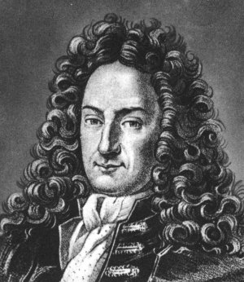
Clean code is not the fastest of all possible codes
Notes:
Gottfried Leibniz Best of all possible worlds

Slide 37
Clean code is optimization for maintainability
It’s not the most efficient / fastest code
It’s not the smallest code either
But will it hurt performance?

Slide 38
Optimization is all about compromises
Notes:
Maybe we can move this to a later section, when we discuss the timeline of software development.
Let's return to that $200,000/year programmer. You can rent 1 AMD EPYC core from Hetzner for $55/year (they sell them in bulk, $220/month for a box of 48, so 220 x 48 / 12 = 55). That means the price of one biological core is the same as the price of 3663 silicon cores. Meaning that if you manage to make the bio core 10% more efficient, you will have saved the equivalent cost of 366 silicon cores. Make the bio core a quarter more efficient, and you'll have saved nearly ONE THOUSAND silicon cores!

Slide 39
Optimization is all about compromises
Optimize for readability
You will hurt runtime performance
You will hurt binary size
Optimize for runtime performance
You will hurt readability
You might hurt portability and binary size
Optimize for binary size
You might hurt readability and portability
You will hurt runtime performance
Notes:
It’s not a code golf how write shortest code
It’s not a contest to achieve the highest levels of performance
It’s also not a race to have 5-10 whatever numberof lines of code methods everywhere

Slide 40
Should we drop clean code for faster code?
What is clean code?
What is software quality?
Where and why do we use C++?
What is software performance?
Is clean code actually slower?
Should we drop clean code for faster code?
Does clean code imply horrible performance?

Slide 41
Sometimes every bit of performance matters
Every 100ms of latency costs Amazon 1% in sales
A broker could loss $4 million/ms in revenue, if a competitor is 5 ms ahead
An extra 500ms in search page generation time, dropped Google’s traffic by 20%
Akamai found that every 100ms delay in a website load time drops the conversion rate by 7%
Notes:
https://www.linkedin.com/pulse/what-actually-software-performance-rodrigo-sipriano/

Slide 42
Performance is crucial for Spotify when you
Open the app
Start playing a track
Tap on any button

Slide 43
Otherwise, there are more important aspects
Small binary
Maintainable code
Notes:
Bigger, maybe on both sides

Slide 44
But even when performance matters, the first answer is not low-level code optimization
Notes:
Not in runtime optimization, where you count cycles, allocations,etc

Slide 45
Algorithmic complexity isn’t always so important
My very first project suffered from
Slow speed
Immense memory leak
Speed or operability was the bigger problem?

Slide 46
Some said speed, culprit was an O(n^4) “algo”
I wasn’t really bothered by that piece of nice code…
I measured and measured
It took a fraction of the execution time

Slide 47
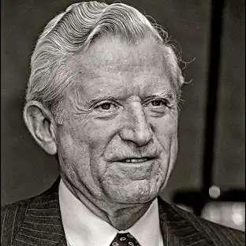
"The overall performance improvement gained by optimizing a single part of a system is limited by the fraction of time that the improved part is actually used" - Amdahl’s law
Notes:
Not in runtime optimization, where you count cycles, allocations,etc

Slide 48
You can often ignore slow code if it’s not on the hot path
Notes:
Not in runtime optimization, where you count cycles, allocations,etc

Slide 49
The key was to use a 3rd party library properly
Some startup / cleanup functions were called too often
Calling them at the right time solved all the imminent issues

Slide 50

Reading documentation and using libraries as they are intended to is more important than writing fast code…
Notes:
USE A MEME HERE

Slide 51
How to support 15x traffic?
Instead of making the code “faster”:
Make your system more scalable
Improve operability
Improve resource utilization
Finetune network settings

Slide 52
Improve operability
Remove memory leaks
Fix core dumps
Remove as much UB as possible

Slide 53
Consolidate external requests
Optimize orders of magnitude slower network/db calls first
If the API offers some batching option, use it!
If not, try to batch it on call site
Think about (local) caching
Think about anything that reduces the number of calls you have to make

Slide 54
But what about all those costly language features?
Notes:
Maybe we can move this to a later section, when we discuss the timeline of software development.

Slide 55
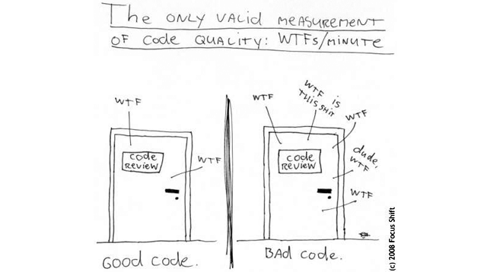
Will the common enemies ruin your performance?
Unnecessary heap allocations?
Copying large objects unnecessarily?
Unnecessary virtual functions?
You won’t have many of those if your code is clean
“Some” usage will not ruin your code

Slide 56
Optimization efforts must be concentrated
Overall performance improvement gain in a single part is limited!
If you follow general best practices you’ll have a reasonable performance
Start optimizing the hot path
Leave the non-hot path clean as long as you prove else

Slide 57
Performance is not l’art pour l’art
Notes:
Maybe we can move this to a later section, when we discuss the timeline of software development.

Slide 58
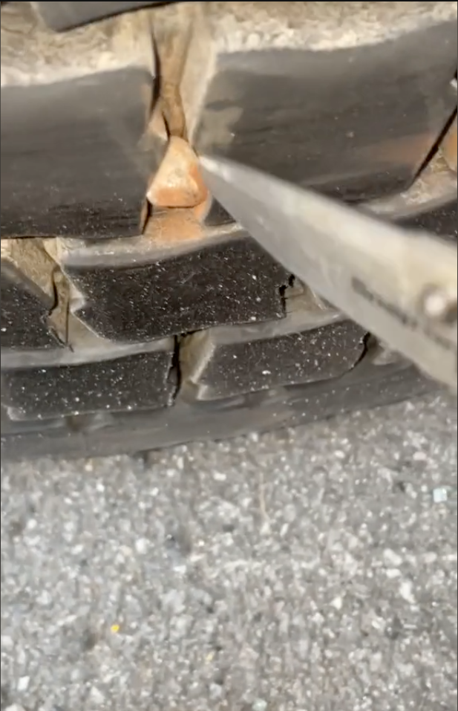
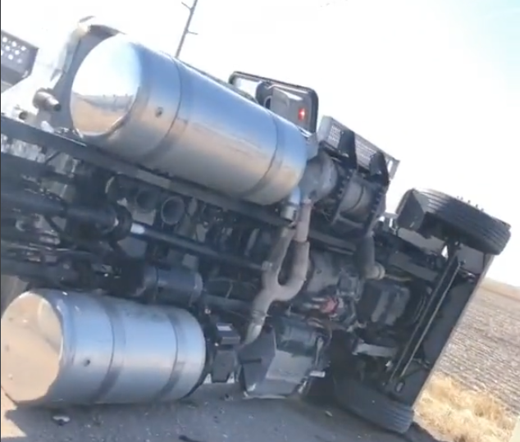
Many devs in a code review

Slide 59
Software engineering is not about performance
Engineering is in the crossroads of defining and recognizing what is good enough
Just because we can do something, we don’t have to
Software engineering is not competitive programming

Slide 60
But why readability is so important?
Notes:
Maybe we can move this to a later section, when we discuss the timeline of software development.

Slide 61
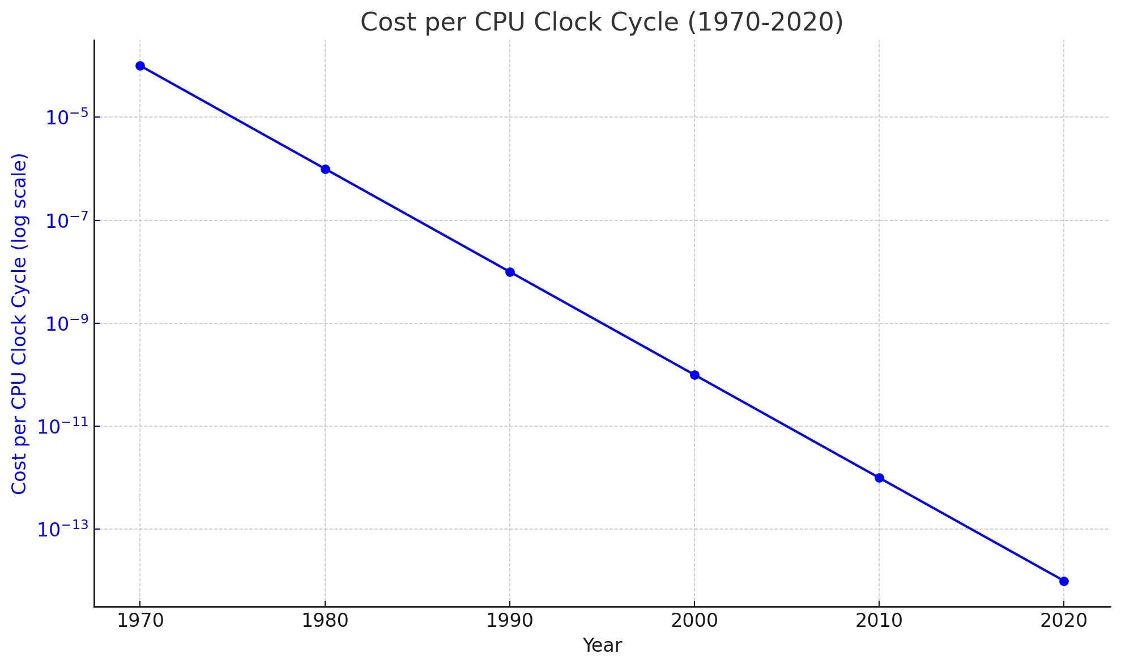
Put here a chart of CPU cycle prices going down
Notes:
Image of punch cards on the side maybe?

Slide 62
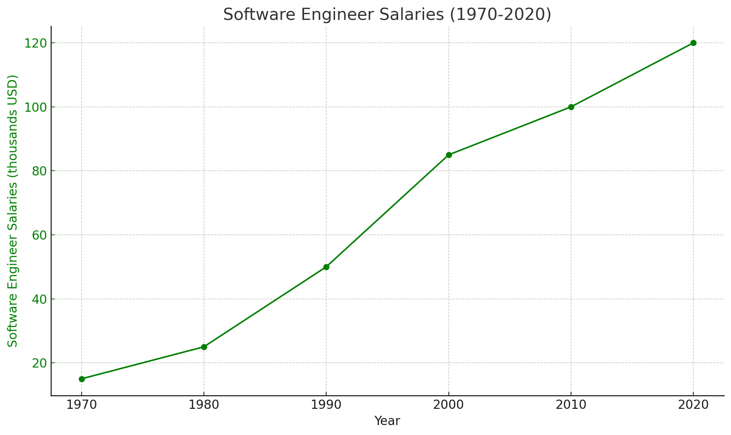
Put here a chart of developer salaries going up

Slide 63
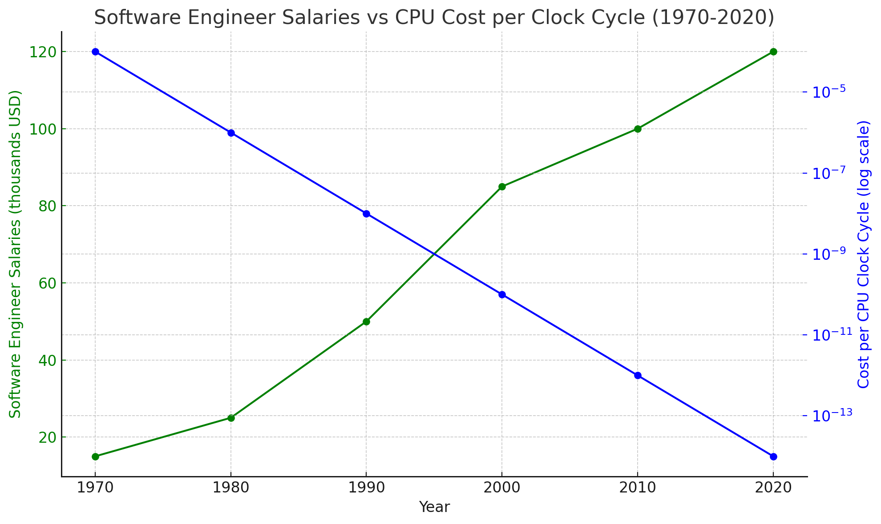
Merge the two charts

Slide 64
Performance is not l’art pour l’art
We have “cheap” and strong hardware
We also have expensive developers
Unless needed, optimize for maintainability
Notes:
Move the chart in small to one side

Slide 65
Does clean code imply horrible performance?
What is clean code?
What is software quality?
Where and why do we use C++?
What is software performance?
Is clean code actually slower?
Should we drop clean code for faster code?
Does clean code imply horrible performance?

Slide 66
Sometimes
Notes:
Maybe we can move this to a later section, when we discuss the timeline of software development.

Slide 67
Sometimes If requirements are extreme…
Notes:
Maybe we can move this to a later section, when we discuss the timeline of software development.

Slide 68
Sometimes If requirements are extreme… In most cases, it won’t
Notes:
Maybe we can move this to a later section, when we discuss the timeline of software development.

Slide 69
In most cases, it won’t, not even in the realm of C++
Your performance issues will come from somewhere else
Optimize how you handle your external requests
Perform low-level optimization only at a few places on the hot path
A bit worse performance and better maintainability will have a better ROI

Slide 70
Clean code! Horrible performance?
Sandor Dargo
Meeting C++ 16th November 2024, Berlin
T W I T T E R @SandorDargo W E B sandordargo.com
Notes:
Main points are:
What is software quality & clean code
Their relationship
What can we do about them

